Slide 1
Preliminary Designs
Aristos, Gabriel, Matthew

Slide 2
Materials
We want a cheap, hard material that won’t warp, is lightweight, and is easy to lasercut
Best options: Acrylic and Duron (Masonite/ Low Density Hardboard)
1/4

Slide 3

Materials - Masonite
Low Density- Medium : 800-1100 kg/m^3
Medium Young’s Modulus: 3.4 GPa
Very easy to glue
2/4

Slide 4

Materials - Acrylic
Medium Density: 1160 kg/m^3
Medium Young’s Modulus: 3 GPa
Resistant to water
Relatively hard
3/4

Slide 5

Material Choice
Our choice = Acrylic
If we find that our design is too heavy, we will switch to low density hardboard to save weight.
4/4

Slide 6
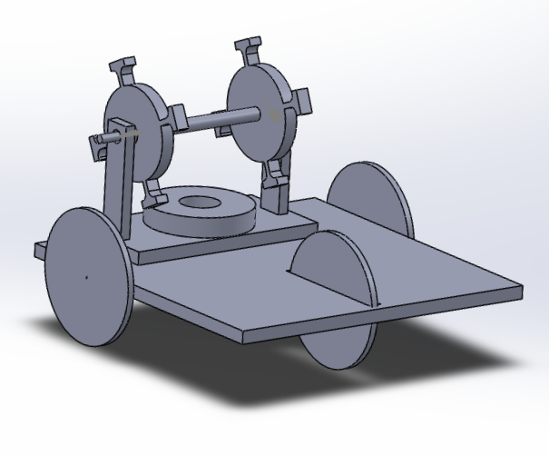
Overall Design
Overall chassis size: 25x25cm (~10x10in)
Wheel diameter: 10cm (~4in)
3 wheels: 2 rear, 1 front
Motor drives rear wheels

Slide 7
Wheel Design
Design Requirements:
Sturdy enough to bear weight
High friction to ensure no slip
Hard material to minimize rolling losses
Thick enough to grip, but not thick so thick as to significantly increase air resistance
1/5

Slide 8
Wheel Design - Materials
Base Material: Acrylic. Masonite tends to split on edge
Surface Material: Need high friction. Rubber bands or adhesive rubber pads along wheel edges to improve coefficient of static friction (rubber μ_{s} = 0.6-1.2)
Axles: Wheels will be rigidly attached to their axles. Axle material will be based on transmission design
2/5

Slide 9
Wheel Design - Shape
Thickness: We will use standard acrylic with moderate thickness. Current design is t_{wheels} = 0.64cm (0.25in). This may change with testing.
Diameter: Sufficient to ensure bottom of chassis clears ground. Increasing wheel diameter increases speed at the cost of increasing required torque. Current design is D_{wheels} = 10cm (3.94in).
Two candidates for outline: Circular (standard) and wheg (wheel + leg)
3/5

Slide 10
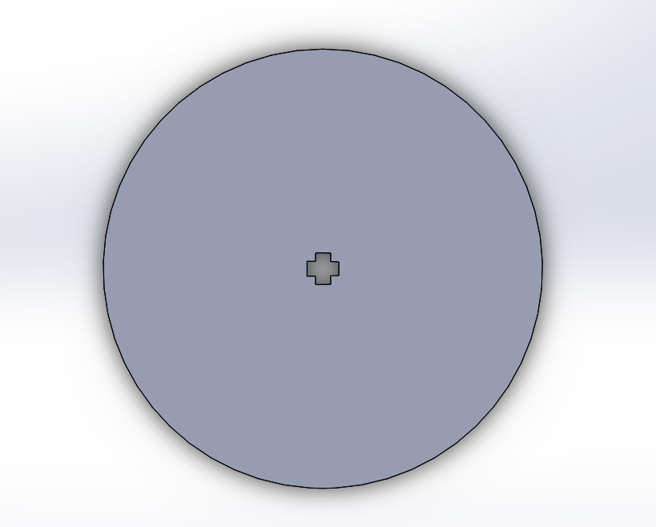
Wheel Design - Circular
Advantages:
Stable chassis position
What cars actually use
Disadvantages:
Difficult to attach surface material
Poor obstacle clearing on bumpy surfaces
4/5

Slide 11
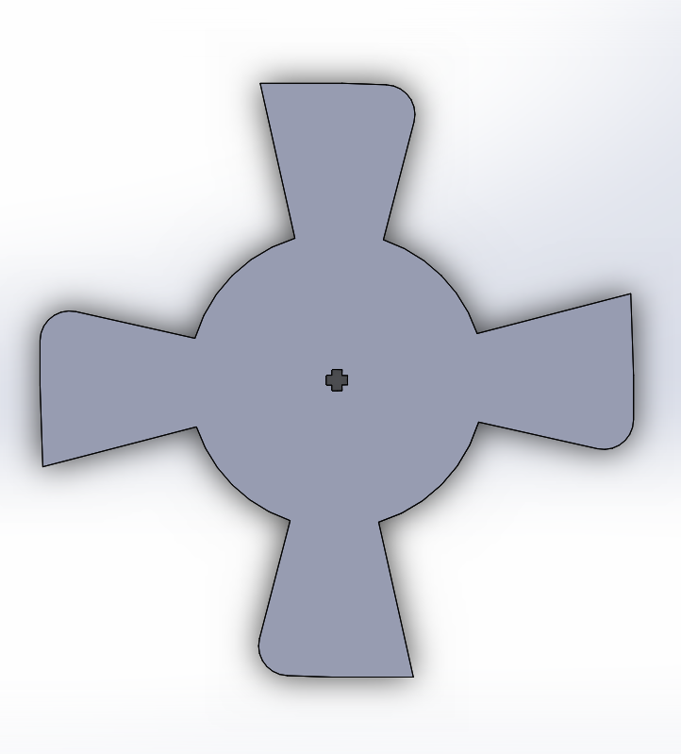
Wheel Design - Wheg
Advantages:
Better obstacle clearing for bumpy surfaces
Avoids slipping (spinning out)
Can tension rubber bands on surface by using crossing rubber bands between legs
Disadvantages:
Causes chassis to move up and down vertically
Not what real cars use
5/5

Slide 12
Motor Design
We need sufficient torque output to propel our vehicle
2 possible designs:
Simple Design: One loop, easy to manufacture, lower power
More Complex: Multiple loops, harder to manufacture, greater power
1/5

Slide 13
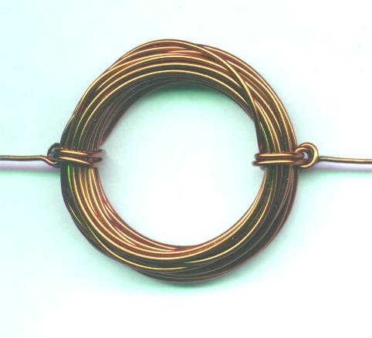
Motor Design - Single Loop
A single wire loop suspended over a permanent magnet
Easy to fabricate
The classic electric motor
2/5

Slide 14
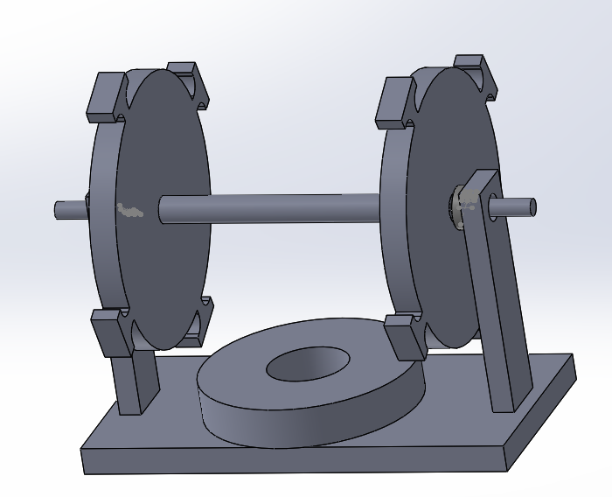
Motor Design - Multi Loop
Multiple wire loops
Potentially higher power
More poles, which avoids problem of dead spots in classic two-pole motor
More challenging to fabricate
3/5

Slide 15
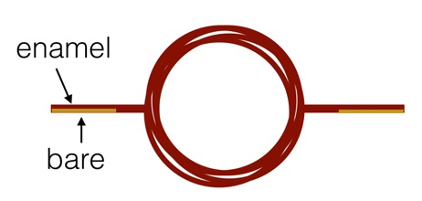
Motor Design - Single Loop Commutation
Creating the commutator simply involves stripping the insulating coating on half of each leg of the loop
4/5

Slide 16
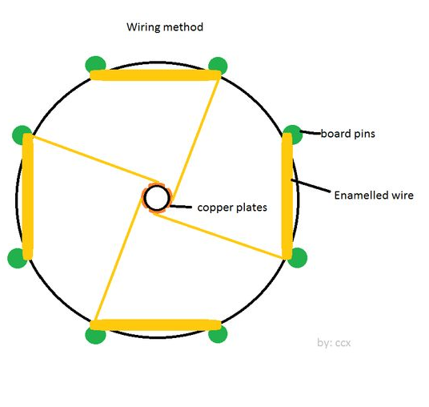
Motor Design - Multi Loop Commutation
The axis of rotation has copper plates that are separated such that only one plate (and therefore loop) conducts at a time.
The challenge is securely attaching the plates to the axis.
5/5

Slide 17
Motor Positioning
To remove room for errors, we would like to have a simple design in which the motor’s plane of rotation is the same as the wheel’s.
We would also like the motor output to sit at the same vertical level as the wheel axles. Therefore the motor magnet should be sunk slightly below the main level of the chassis.

Slide 18
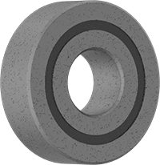
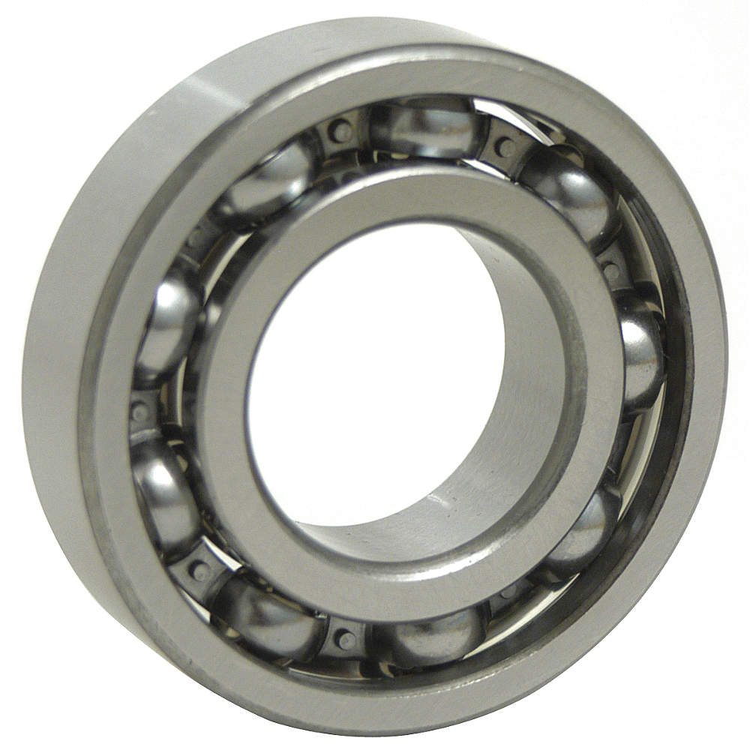
Attachments
Radial Ball Bearings
Axial rotation
Low friction
Poor heat dissipation - likely doesn’t matter for our application
Use in motor and wheel axles

Slide 19
Gear Ratio
Speed is not a consideration. We will primarily focus on ensuring there is sufficient torque to propel the car forward.
High gear ratio intended to allow motor to turn at optimal speed
Precise gear ratio will be decided after building and testing motor. Initially we made many assumptions
1/4

Slide 20
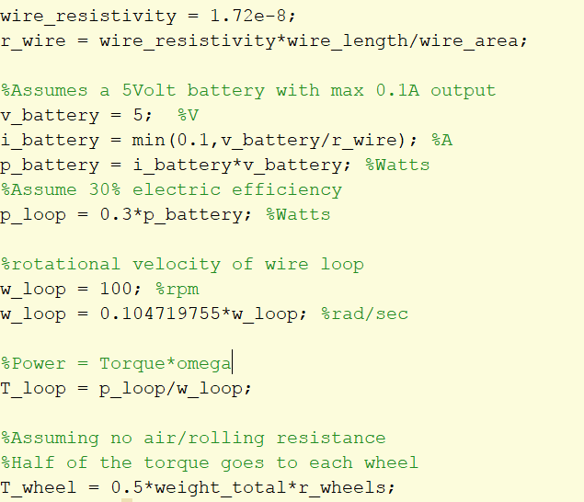
Gear Ratio
2/4

Slide 21
Gear Ratio
3/4

Slide 22
Gear Ratio
We made major assumption in finding the gear ratio
Based on these assumptions we find we need a gear ratio of 25:1
Once we get info on the battery and take necessary measurements we can plug these into the MatLab script to find more exact ratio
4/4

Slide 23
Next Steps
Get battery specs
Fabricate initial motors
Take measurements from battery + motor to produce next design iteration

